Slide 1
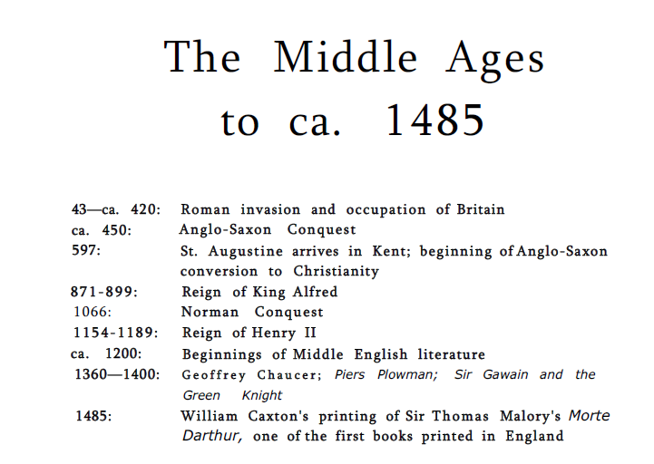

Slide 2
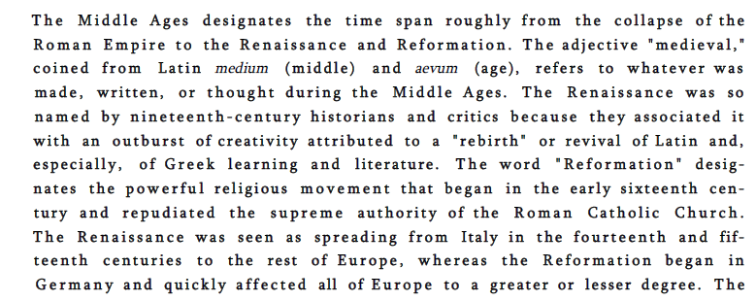

Slide 3
Although the Roman Catholic Church provided continuity, the period was one of enormous historical, social, and linguistic change. To emphasize these changes and the events underlying them, we have divided the period into three primary sections: Anglo-Saxon Literature, Anglo-Norman Literature, and Middle English Literature in the Fourteenth and Fifteenth Centuries. The Anglo- Saxon invaders, who began their conquest of the southeastern part of Britain around 450, spoke an early form of the language we now call Old English.
The changes already in progress in the language and culture of Anglo-Saxon England were greatly accelerated by the Norman Conquest of 1066. The ascendancy of a French-speaking ruling class had the effect of adding a vast number of French loan words to the English vocabulary. The conquest resulted in new forms of political organization and administration, architecture, and literary expression.

Slide 4
Anglo-Saxon Literature
The Wanderer
Beowulf
Bede, Ecclesiastical History of the English People,
The Battle of Maldon
Boethius's Consolation of Philosophy
Anglo-Saxon Chronicles
Dream of the Rood
Caedmon

Slide 5
Anglo-Norman Literature
Marie de France
Chretien de Troyes
The Owl and the Nightingale

Slide 6
14th Century
1348 Black Death
Bocaccio’s Decameron
Dante’s The Divine Comedy
Geoffrey Chaucer, The Canterbury Tales, The House of Fame
Piers Plowman, William Langland
Pearl
Sir Gawain and the Green Knight
Julian of Norwich

Slide 7
15th century
Battle of Agincourt
The War of the Roses
John Lydgate
Margery Kempe
Sir Thomas Malory, Arthur and his knights, Morte D’Arthur

Slide 8
Homeworks
Beowulf,
Sir Gawain and the Green Knight,
Chaucer,
The Canterbury Tales
William Langland

Slide 9
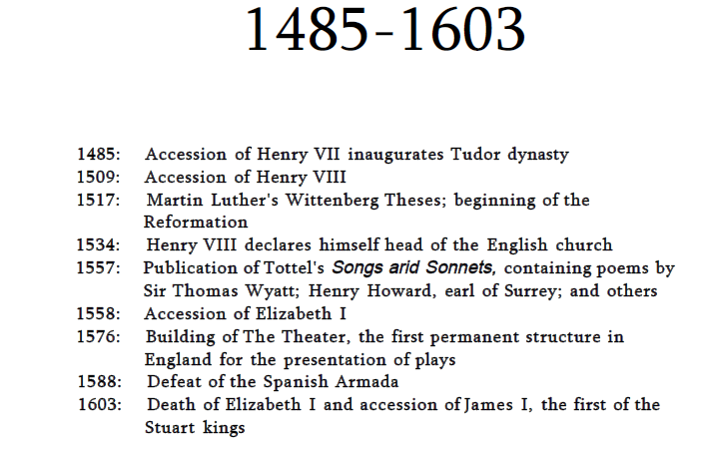
The 16th Century

Slide 10
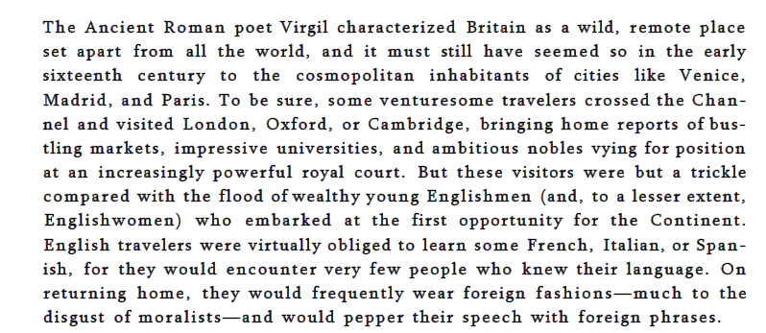

Slide 11
Thomas More’s Utopia, written in Latin
The court was a center of culture as well as power: court entertainments such as theater and masque (a sumptuous, elaborately costumed performance of dance, song, and poetry); court fashions in dress and speech; court tastes in painting, music, and poetry—all shaped the taste and the imagination of the country as a whole. Culture and power were not, in any case, easily separable in Tudor England.
Renaissance, humanism, classical revival, Italy
Reformation
Elizabeth, theatre
Shakespeare

Slide 12
Homeworks
Thomas More, Utopia,
Edmund Spenser, The Faerie Queene,
Sir Philip Sidney,
William Shakespeare, Othello, Macbeth

